Slide 2

Google Drive Database Design
bbv Software Services AG | Date

Slide 3

Agenda
Google Drive functions and database design as followed
Resolve Permission in Google Drive
Full-text Search with BM25
Q&A

Slide 4

Google Drive functions and database design as followed

Slide 5
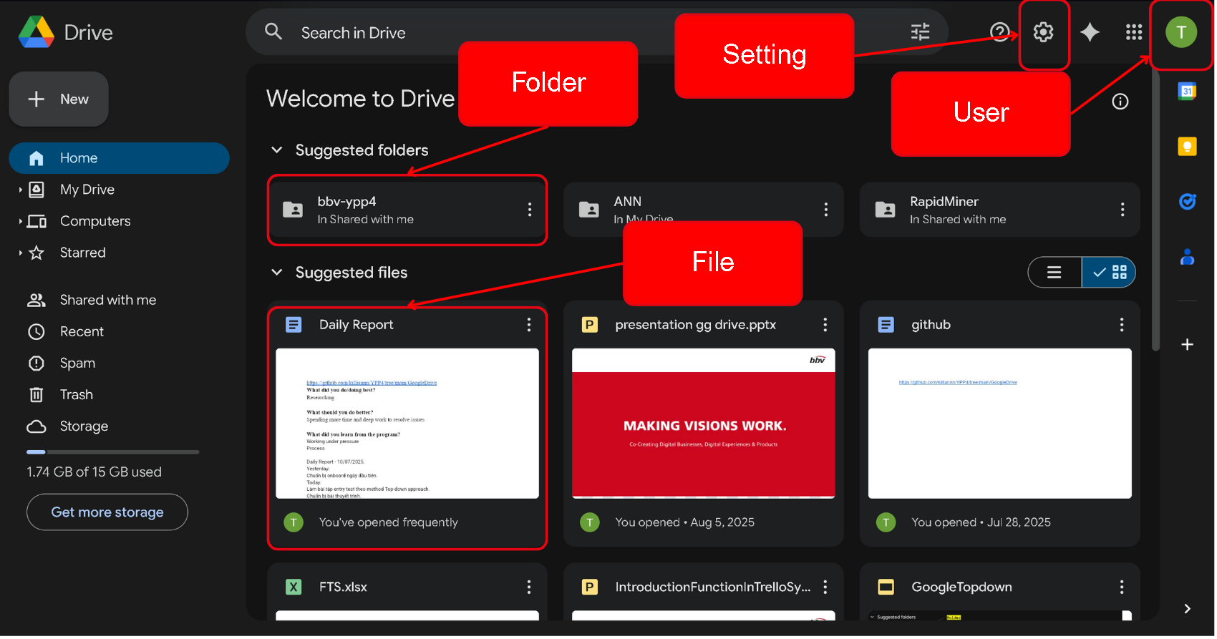
First Screen

Slide 6
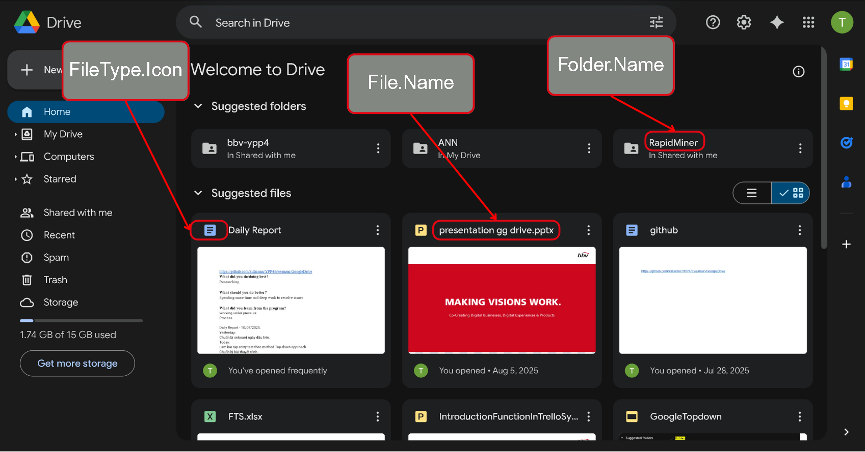
First Screen

Slide 7
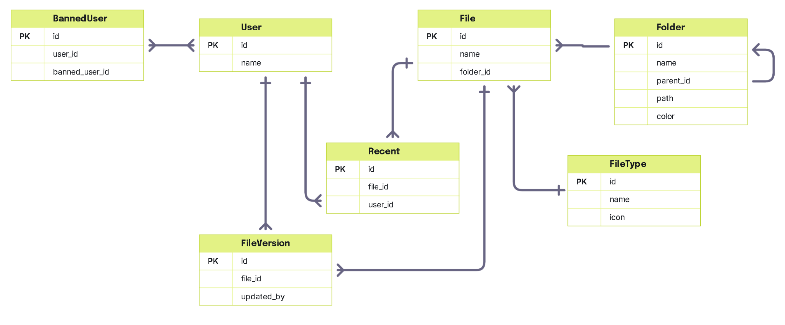
Database Structure For First Screen

Slide 8
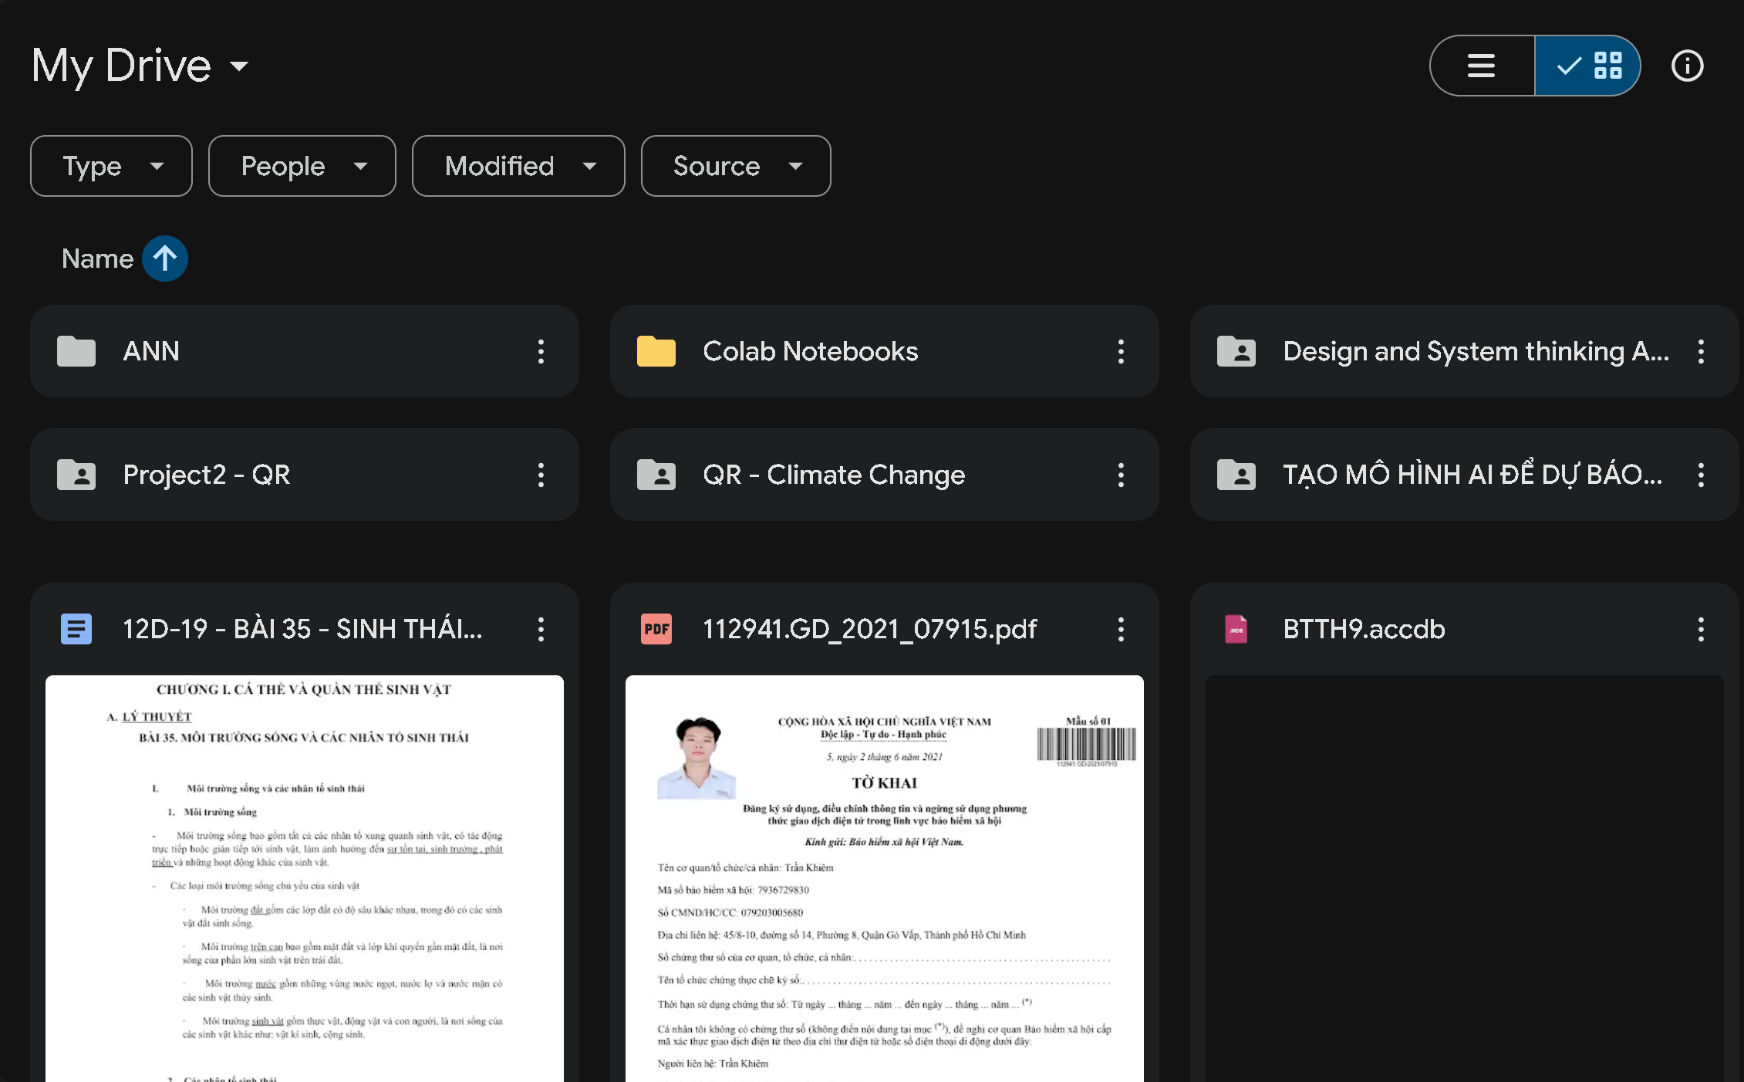
Get folder
Get file
Notes:
--get folders of an user
select
f.id,
f.Name as FolderName,
f.Path as FolderPath,
f.UpdatedAt as FolderUpdateTime,
f.Size
from Folder f
join Users u on f.OwnerId = u.Id
where u.id = 1
and f.Status = 'active'
order by f.UpdatedAt DESC;
--get files of an user
select
f.id,
f.Name as [FileName],
f.Path as FilePath,
f.ModifiedDate as FileUpdateTime,
ft.Name as FileType,
f.Size
from Files f
join Users u on f.OwnerId = u.Id
join FileType ft on f.FileTypeId = ft.Id
where u.id = 1
and f.Status = 'active'
order by f.ModifiedDate;

Slide 9
Get file
Get folder
select
f.id,
f.Name as [FileName],
f.Path as FilePath,
f.ModifiedDate as FileUpdateTime,
ft.Name as FileType,
ft.Icon,
f.Size
from Files f
join Users u on f.OwnerId = u.Id
join FileType ft on f.FileTypeId = ft.Id
where u.id = 1
and f.Status = 'active'
order by f.ModifiedDate;
select
f.id,
f.Name as FolderName,
f.Path as FolderPath,
f.UpdatedAt as FolderUpdateTime,
f.Size
from Folder f
join Users u on f.OwnerId = u.Id
where u.id = 1
and f.Status = 'active'
order by f.UpdatedAt DESC;
Notes:
--get folders of an user
select
f.id,
f.Name as FolderName,
f.Path as FolderPath,
f.UpdatedAt as FolderUpdateTime,
f.Size
from Folder f
join Users u on f.OwnerId = u.Id
where u.id = 1
and f.Status = 'active'
order by f.UpdatedAt DESC;
--get files of an user
select
f.id,
f.Name as [FileName],
f.Path as FilePath,
f.ModifiedDate as FileUpdateTime,
ft.Name as FileType,
f.Size
from Files f
join Users u on f.OwnerId = u.Id
join FileType ft on f.FileTypeId = ft.Id
where u.id = 1
and f.Status = 'active'
order by f.ModifiedDate;

Slide 10
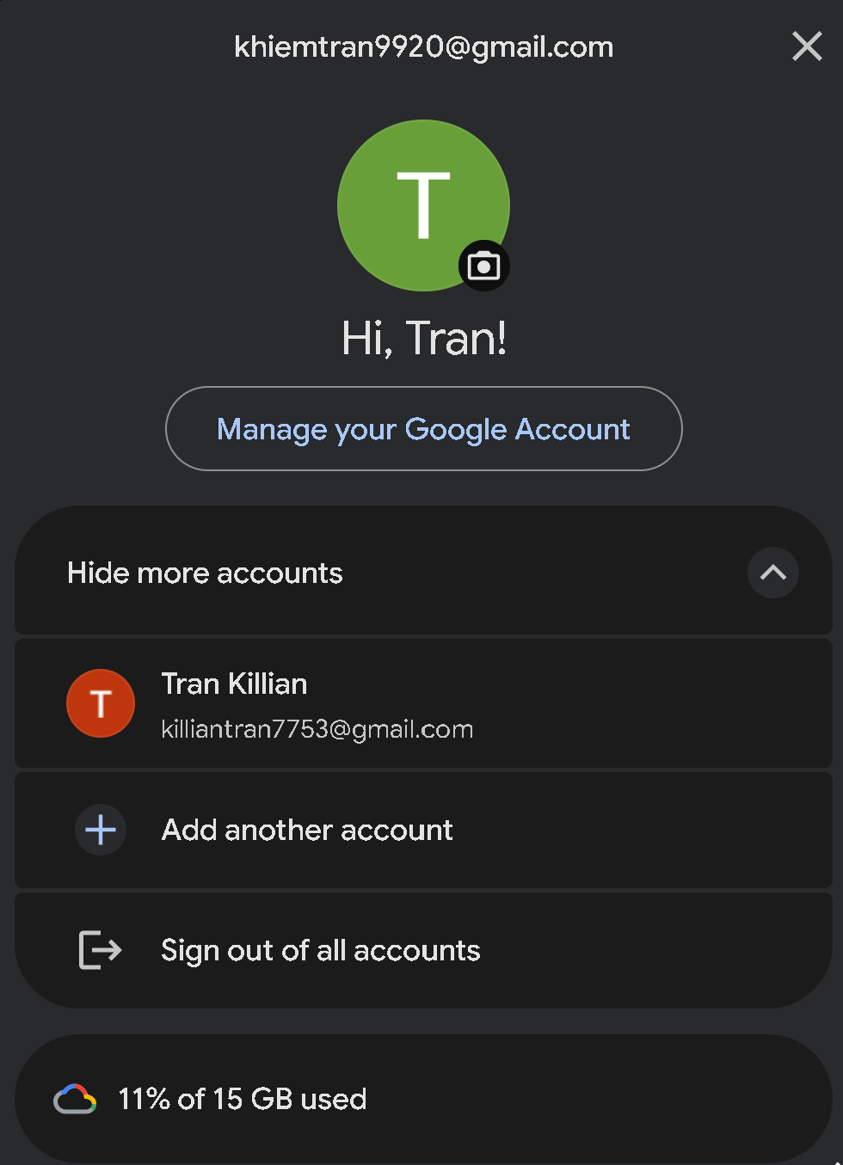
User.Email
User.AvatarURL
User.Name
Notes:
select
u.id,
u.Name as UserName,
u.Email as UserEmail,
u.LastLogin as UserLastLogin
from Users u
where u.id = 1;

Slide 11
Get user information
select
u.id,
u.Name as UserName,
u.Email as UserEmail,
u.AvatarURL as Avatar
from Users u
where u.id = 1;
Notes:
select
u.id,
u.Name as UserName,
u.Email as UserEmail,
u.LastLogin as UserLastLogin
from Users u
where u.id = 1;

Slide 12
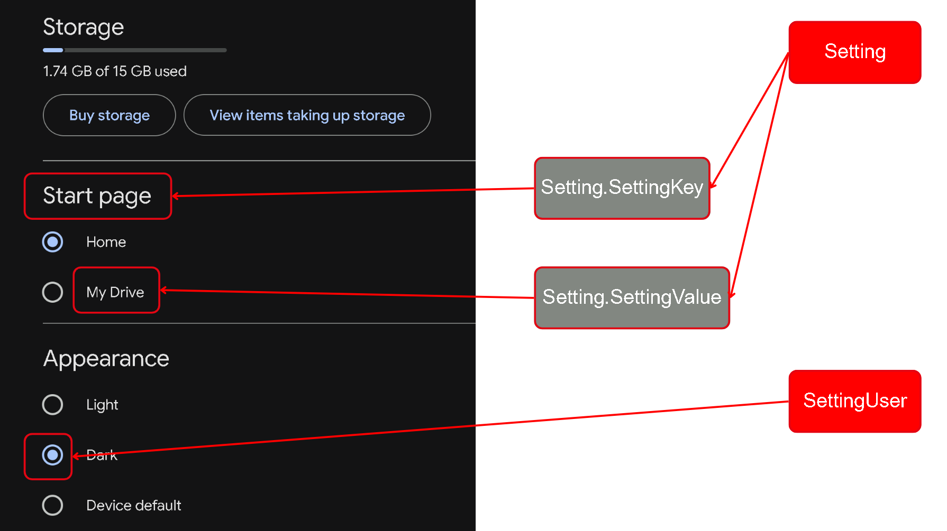
Table For Setting Feature

Slide 13
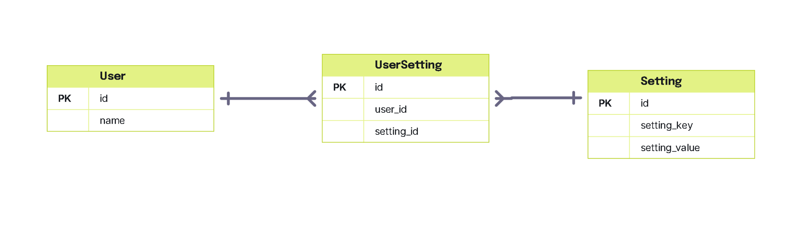
Table For Setting Feature

Slide 14
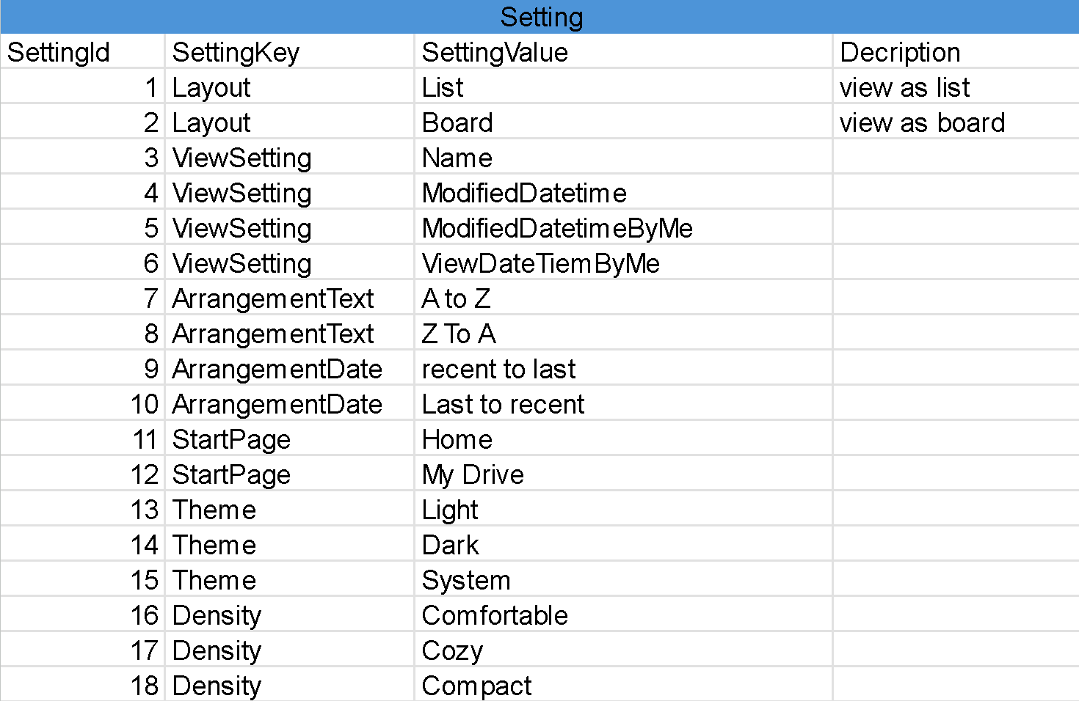
Setting Sample Data

Slide 15
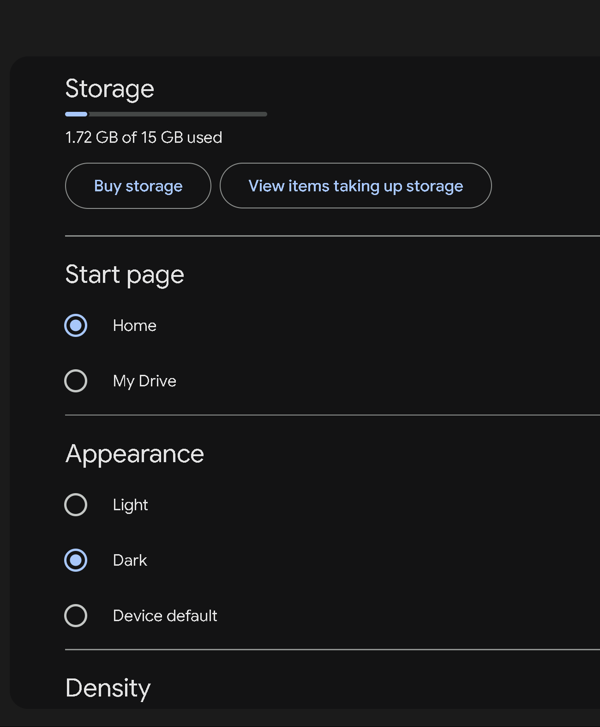
Get user setting
select
u.Name as UserName,
s.SettingKey,
s.SettingValue
from SettingUser su
join Users u on su.UserId = u.Id
join Setting s on su.SettingId = s.Id
where u.Id =1
SettingKey
SettingValue
Notes:
select
u.Name as UserName,
s.SettingKey,
s.SettingValue
from SettingUser su
join Users u on su.UserId = u.Id
join Setting s on su.SettingId = s.Id
where u.Id =1

Slide 16
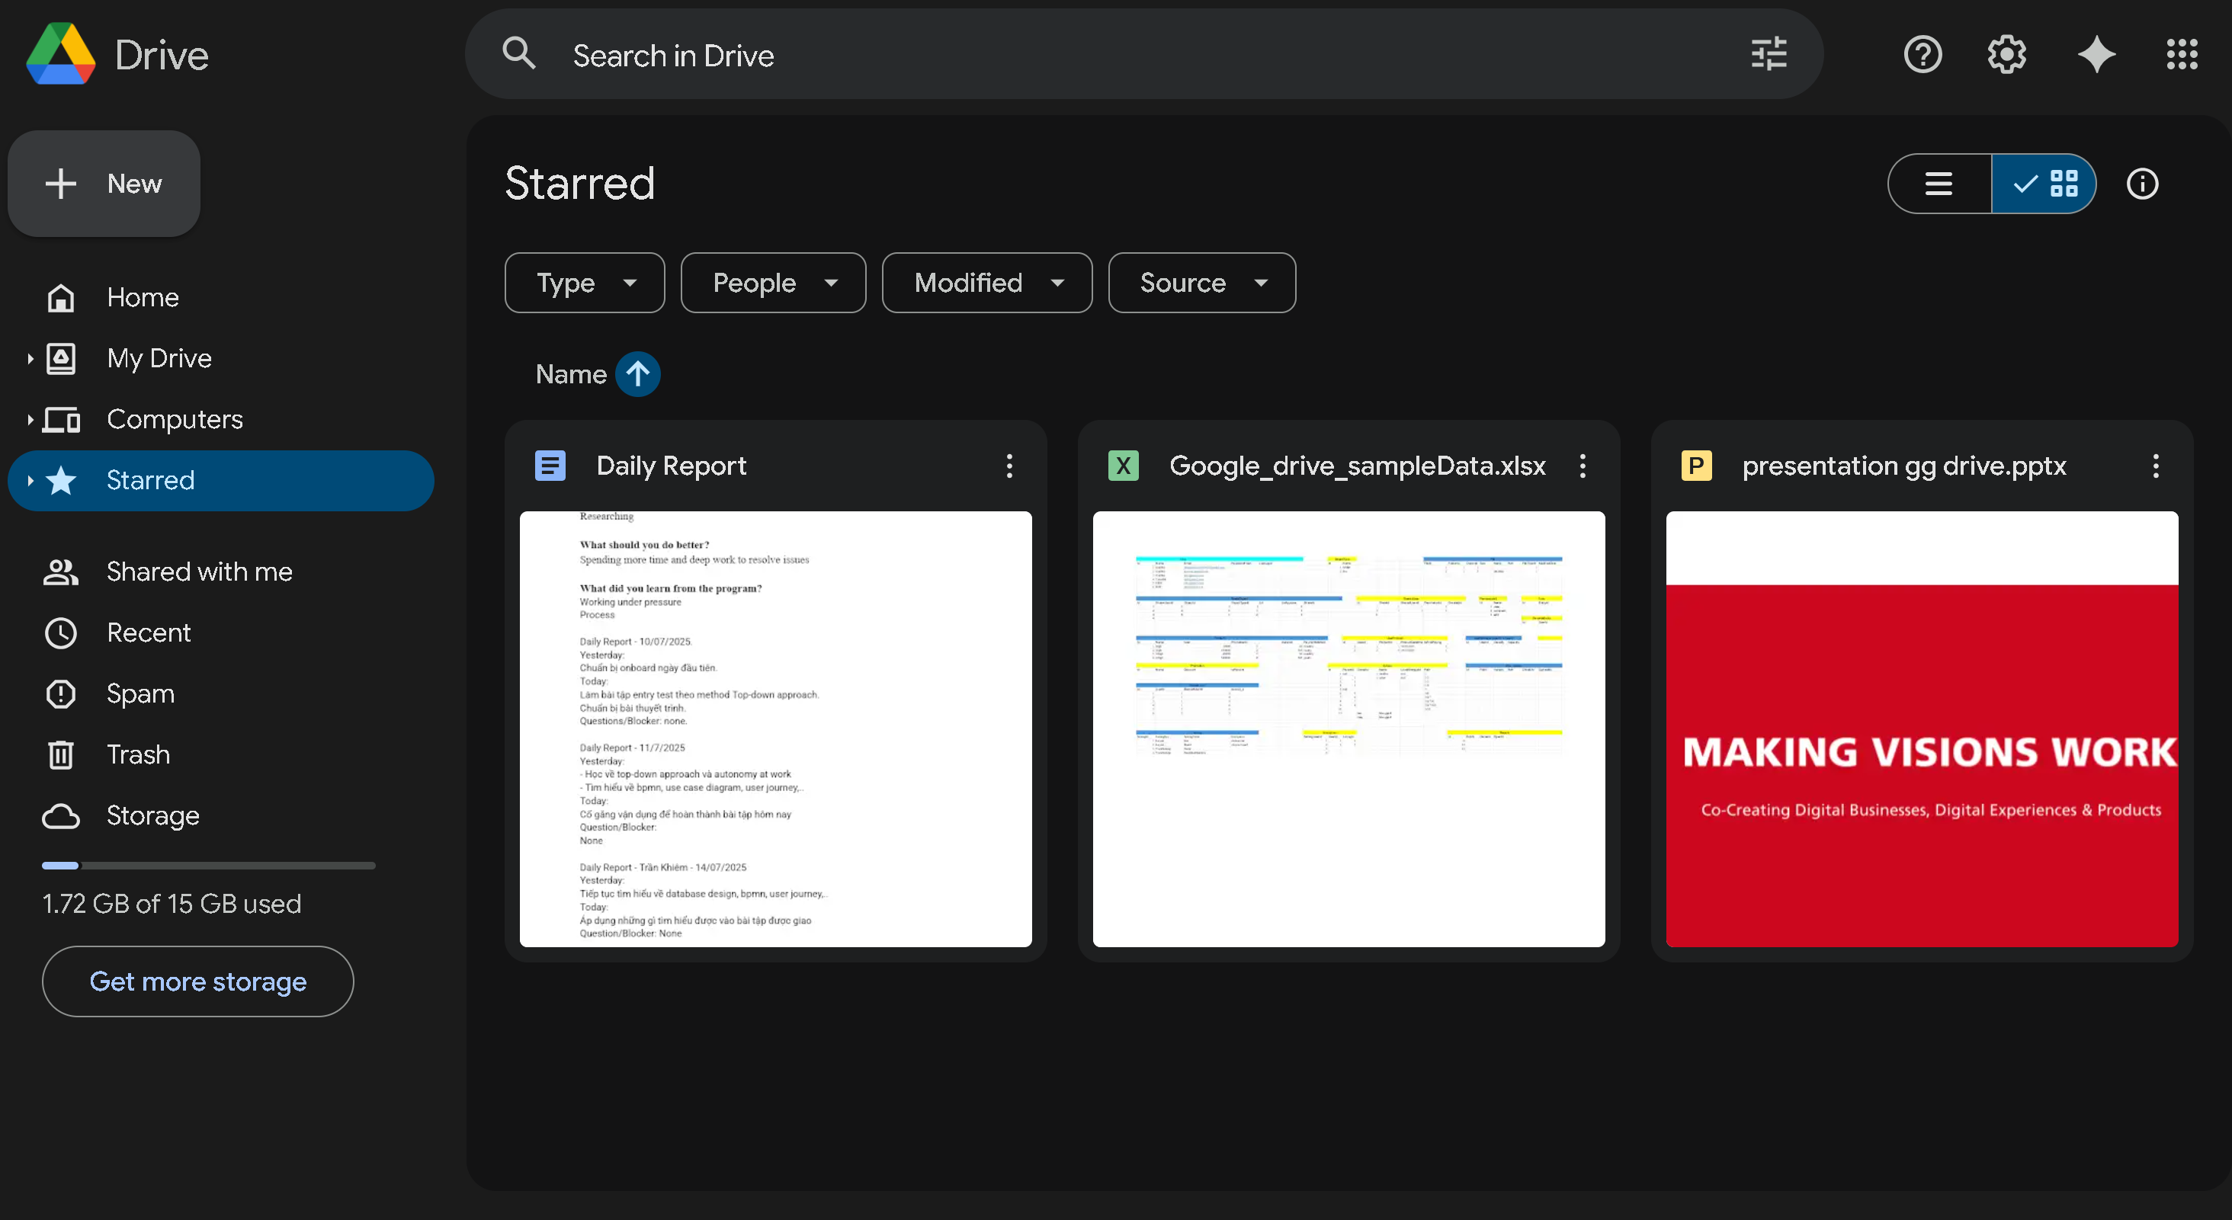
Get starred objects
Notes:
select
fo.id,
fo.ObjectId,
fo.ObjectTypeId,
ot.Name as ObjectType,
case
when fo.ObjectTypeId = 1 then f.Name
else fi.Name
end as [Name]
from FavoriteObject fo
join Users u on fo.OwnerId = u.Id
join ObjectType ot on fo.ObjectTypeId = ot.Id
left join Folder f on fo.ObjectId = f.Id AND fo.ObjectTypeId = 1
left join Files fi on fo.ObjectId = fi.Id AND fo.ObjectTypeId = 2
where fo.OwnerId = 1
order by ot.Name;

Slide 17
Get starred objects
select
fo.id,
fo.ObjectId,
fo.ObjectTypeId,
ot.Name as ObjectType,
case
when fo.ObjectTypeId = 1 then f.Name
else fi.Name
end as [Name]
from FavoriteObject fo
join Users u on fo.OwnerId = u.Id
join ObjectType ot on fo.ObjectTypeId = ot.Id
left join Folder f on fo.ObjectId = f.Id AND fo.ObjectTypeId = 1
left join Files fi on fo.ObjectId = fi.Id AND fo.ObjectTypeId = 2
where fo.OwnerId = 1
order by ot.Name;
Notes:
select
fo.id,
fo.ObjectId,
fo.ObjectTypeId,
ot.Name as ObjectType,
case
when fo.ObjectTypeId = 1 then f.Name
else fi.Name
end as [Name]
from FavoriteObject fo
join Users u on fo.OwnerId = u.Id
join ObjectType ot on fo.ObjectTypeId = ot.Id
left join Folder f on fo.ObjectId = f.Id AND fo.ObjectTypeId = 1
left join Files fi on fo.ObjectId = fi.Id AND fo.ObjectTypeId = 2
where fo.OwnerId = 1
order by ot.Name;

Slide 18
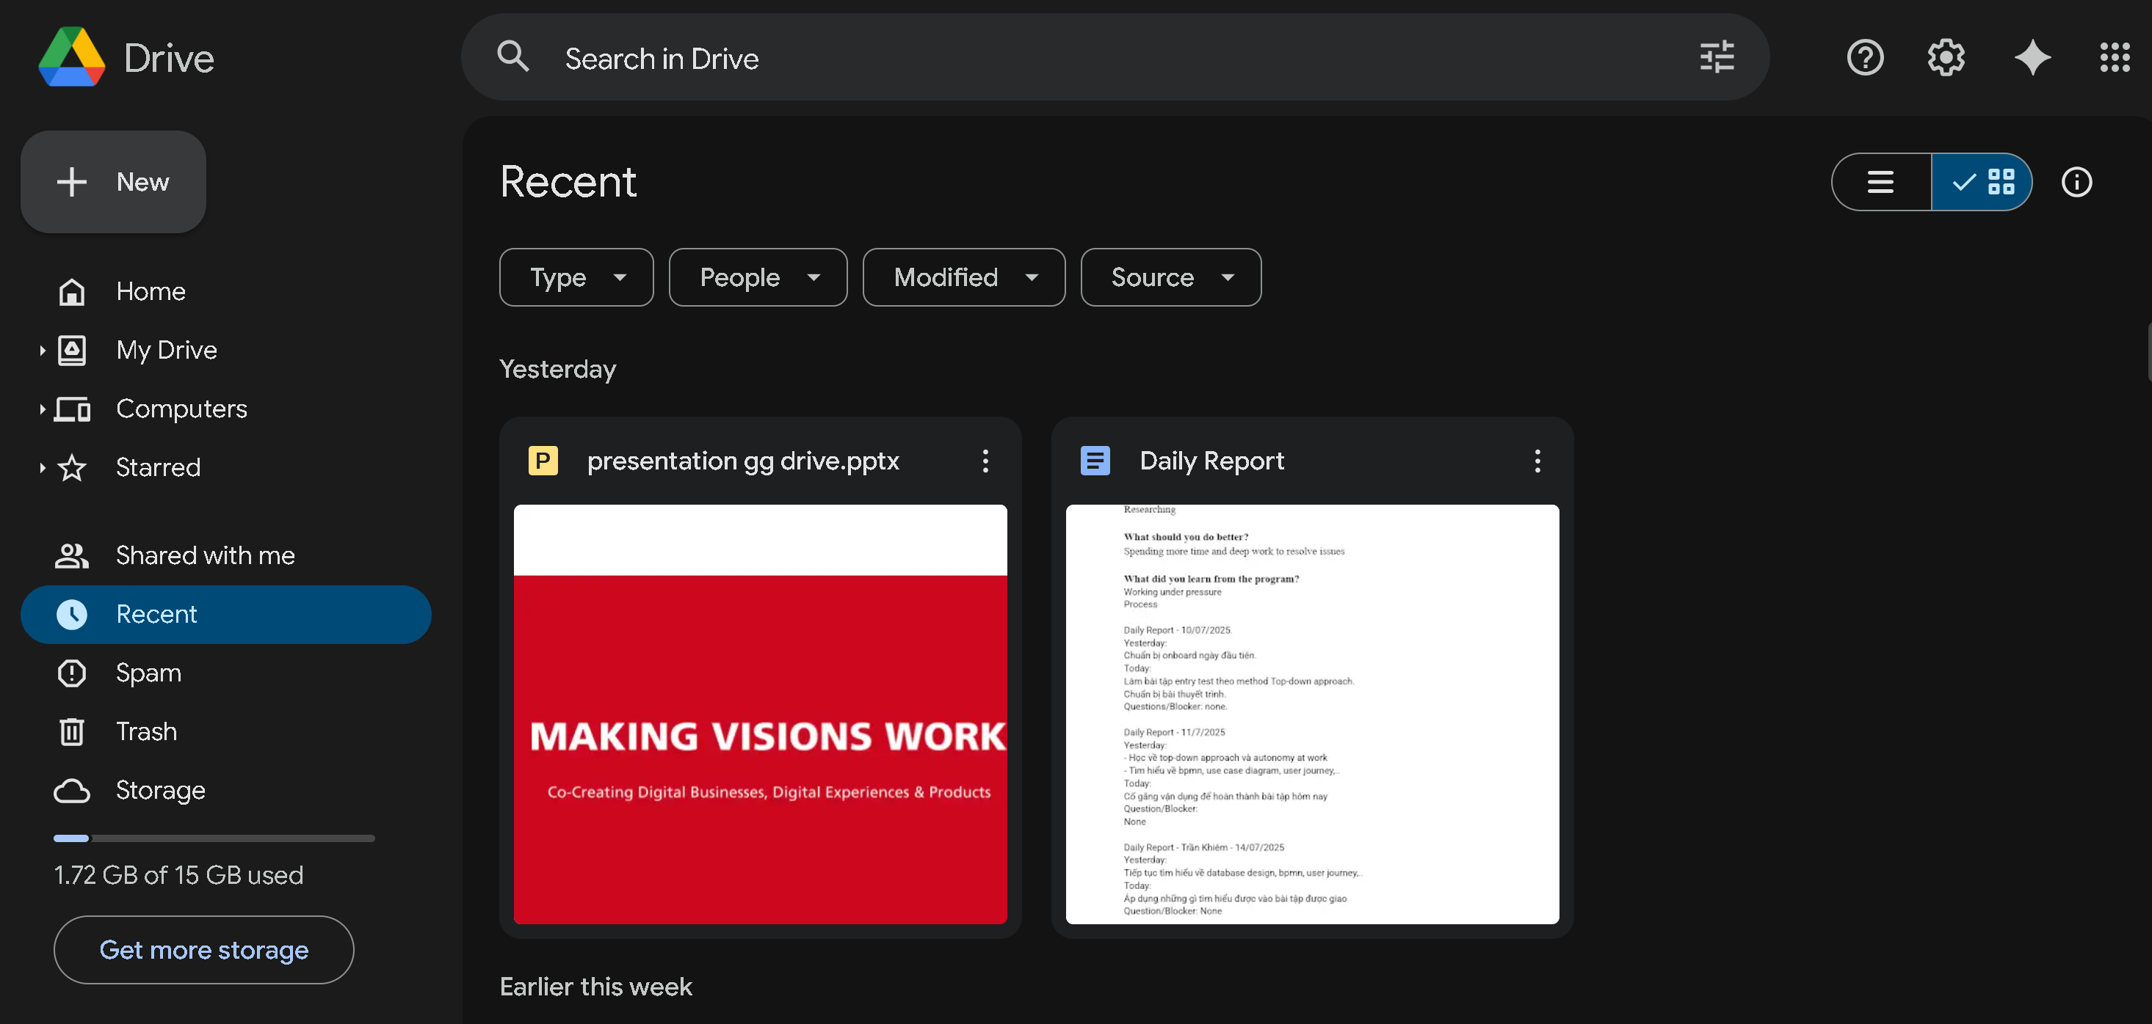
Get recent objects of an user
Notes:
select
r.Id,
case
when r.ObjectTypeId = 1 then f.Name
else fi.Name
end as [Name],
case
when r.ObjectTypeId = 1 then f.Path
else fi.Path
end as [Name],
ft.Name as FileType,
r.DateTime as LastAccessed
from Recent r
join Users u on r.Id = u.Id
left join Folder f on f.Id = r.ObjectId and r.ObjectTypeId = 1
left join Files fi on fi.Id = r.ObjectId and r.ObjectTypeId =2
join FileType ft on fi.FileTypeId = ft.Id
where r.UserId = 1
order by r.DateTime DESC;

Slide 19
Get recent objects of an user
select
r.Id,
case
when r.ObjectTypeId = 1 then f.Name
else fi.Name
end as [Name],
case
when r.ObjectTypeId = 1 then f.Path
else fi.Path
end as [Name],
ft.Name as FileType,
r.DateTime as LastAccessed
from Recent r
join Users u on r.Id = u.Id
left join Folder f on f.Id = r.ObjectId and r.ObjectTypeId = 1
left join Files fi on fi.Id = r.ObjectId and r.ObjectTypeId =2
join FileType ft on fi.FileTypeId = ft.Id
where r.UserId = 1
order by r.DateTime DESC;
Notes:
select
r.Id,
case
when r.ObjectTypeId = 1 then f.Name
else fi.Name
end as [Name],
case
when r.ObjectTypeId = 1 then f.Path
else fi.Path
end as [Name],
ft.Name as FileType,
r.DateTime as LastAccessed
from Recent r
join Users u on r.Id = u.Id
left join Folder f on f.Id = r.ObjectId and r.ObjectTypeId = 1
left join Files fi on fi.Id = r.ObjectId and r.ObjectTypeId =2
join FileType ft on fi.FileTypeId = ft.Id
where r.UserId = 1
order by r.DateTime DESC;

Slide 20
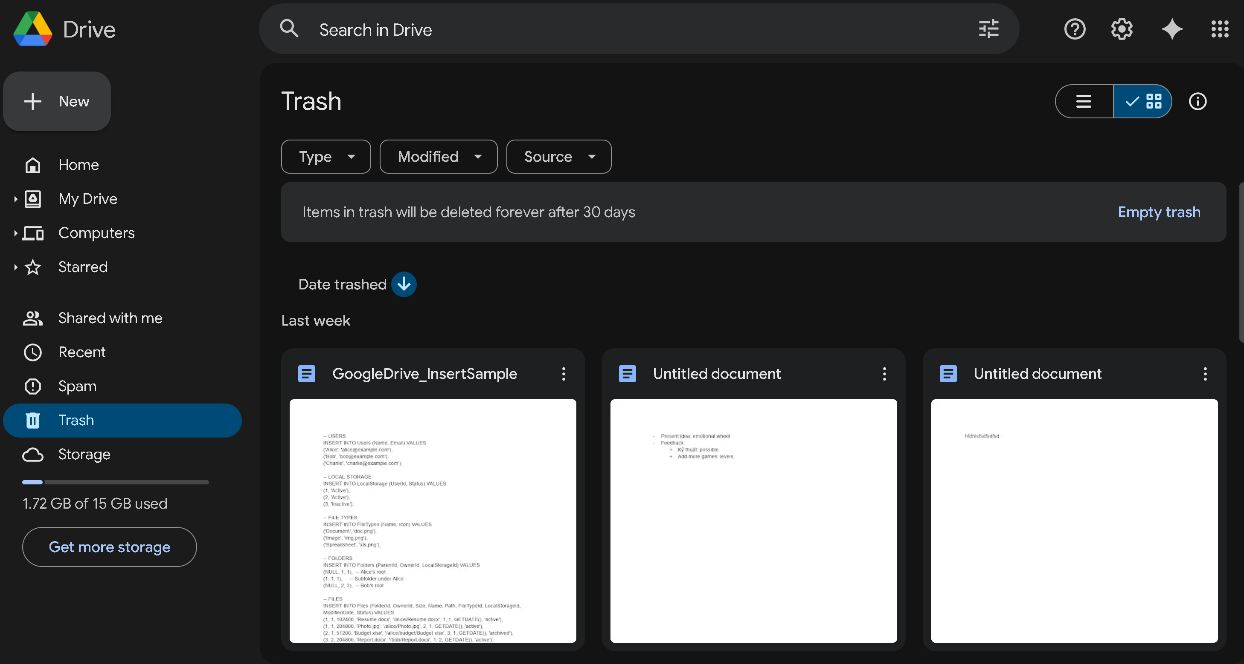
Get trash objects of an user
Notes:
select
t.id,
t.ObjectId,
t.ObjectTypeId,
t.RemovedDatetime,
case
when t.ObjectTypeId = 1 then f.Name
else fi.Name
end as [Name]
from Trash t
join Users u on t.UserId = u.Id
join ObjectType ot on t.ObjectTypeId = ot.id
left join Folder f on t.ObjectId = f.Id and t.ObjectTypeId = 1
left join Files fi on t.ObjectId = fi.Id and t.ObjectTypeId =2
where t.UserId = 1
order by t.RemovedDateTime DESC;

Slide 21
Get trash objects of an user
select
t.id,
t.ObjectId,
t.ObjectTypeId,
t.RemovedDatetime,
case
when t.ObjectTypeId = 1 then f.Name
else fi.Name
end as [Name]
from Trash t
join Users u on t.UserId = u.Id
join ObjectType ot on t.ObjectTypeId = ot.id
left join Folder f on t.ObjectId = f.Id and t.ObjectTypeId = 1
left join Files fi on t.ObjectId = fi.Id and t.ObjectTypeId =2
where t.UserId = 1
order by t.RemovedDateTime DESC;
Notes:
select
t.id,
t.ObjectId,
t.ObjectTypeId,
t.RemovedDatetime,
case
when t.ObjectTypeId = 1 then f.Name
else fi.Name
end as [Name]
from Trash t
join Users u on t.UserId = u.Id
join ObjectType ot on t.ObjectTypeId = ot.id
left join Folder f on t.ObjectId = f.Id and t.ObjectTypeId = 1
left join Files fi on t.ObjectId = fi.Id and t.ObjectTypeId =2
where t.UserId = 1
order by t.RemovedDateTime DESC;

Slide 22
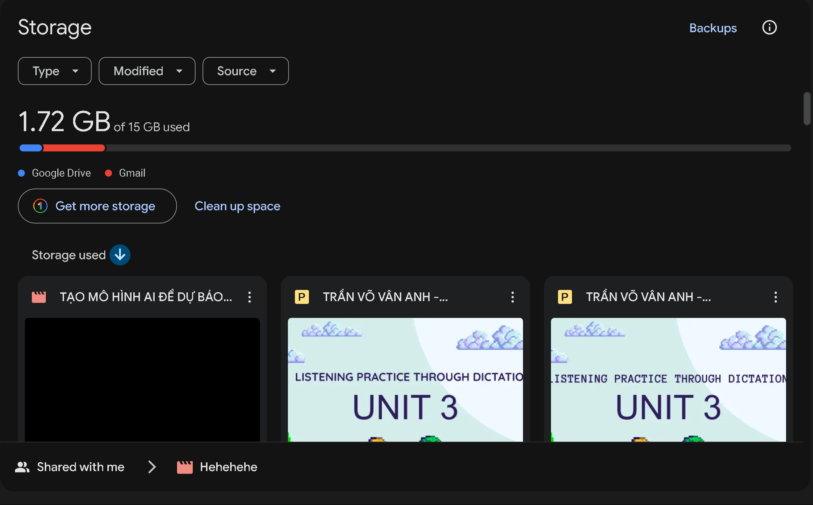
Get storage
Get list file by size
Notes:
--get storage information of an user
select
u.Capacity,
u.UsedCapacity,
u.Capacity - u.UsedCapacity as RemainingCapacity
from Users u
where u.Id = 1
order by RemainingCapacity DESC;
select
f.Name as FileName,
f.Size
from Files f
join Users u on f.OwnerId = u.Id
where u.id = 1
order by f.Size DESC;

Slide 23
Get storage
Get list file by size
select
u.Capacity,
u.UsedCapacity,
u.Capacity - u.UsedCapacity as RemainingCapacity
from Users u
where u.Id = 1
order by RemainingCapacity DESC;
select
f.Name as FileName,
f.Size
from Files f
join Users u on f.OwnerId = u.Id
where u.id = 1
order by f.Size DESC;
Notes:
--get storage information of an user
select
u.Capacity,
u.UsedCapacity,
u.Capacity - u.UsedCapacity as RemainingCapacity
from Users u
where u.Id = 1
order by RemainingCapacity DESC;
select
f.Name as FileName,
f.Size
from Files f
join Users u on f.OwnerId = u.Id
where u.id = 1
order by f.Size DESC;

Slide 24
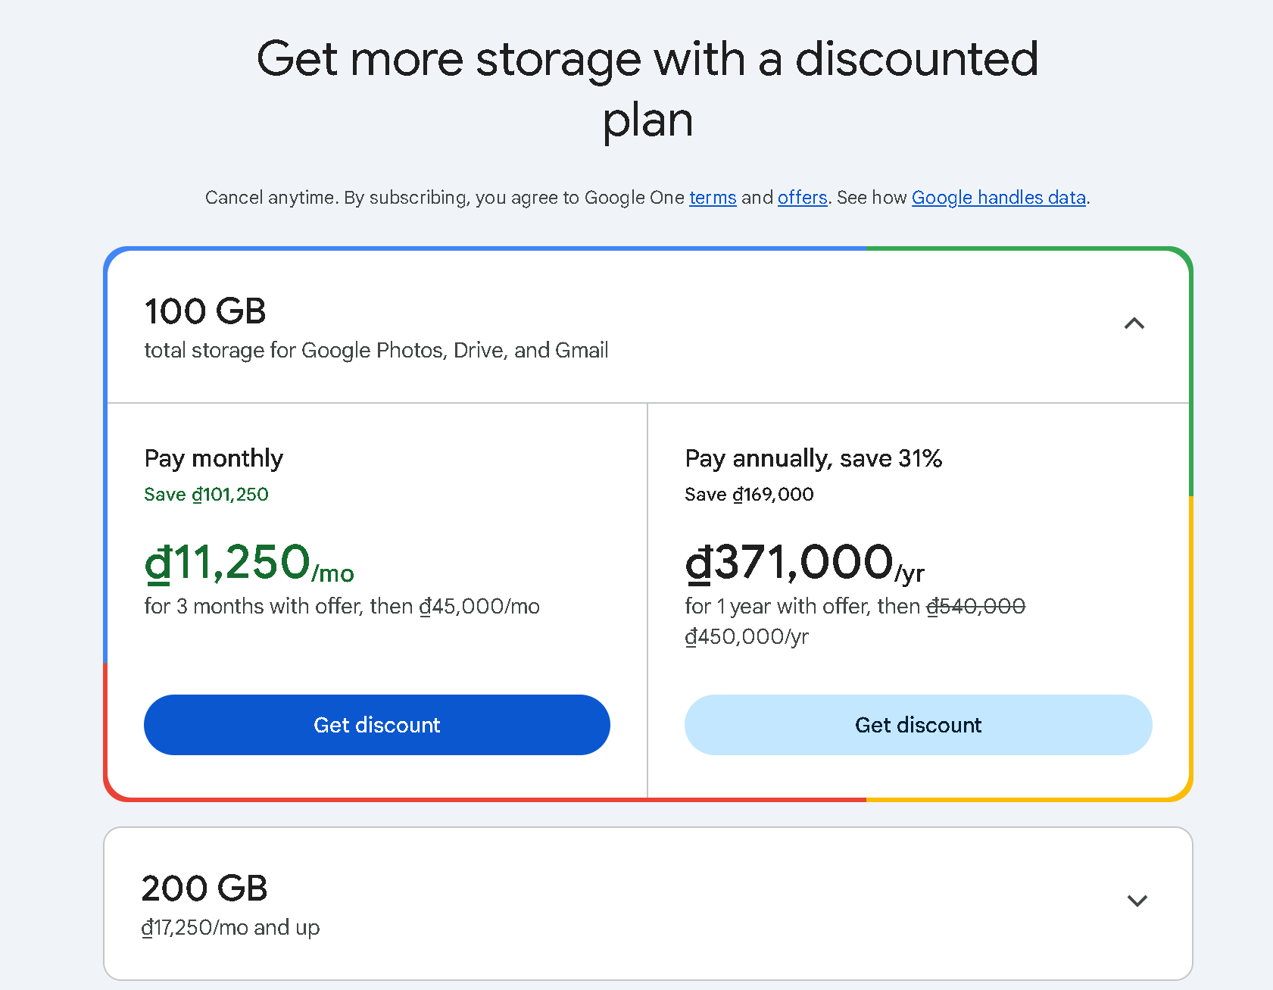
Product UI
Product
Product.Duration
Product.Amount
Promotion

Slide 25
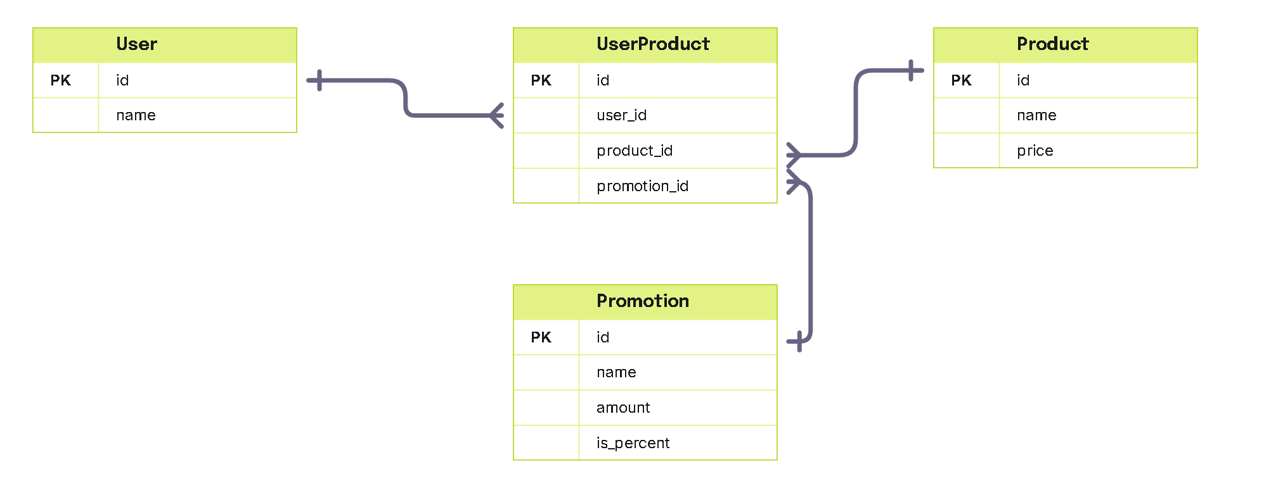
Table for Product Feature

Slide 26
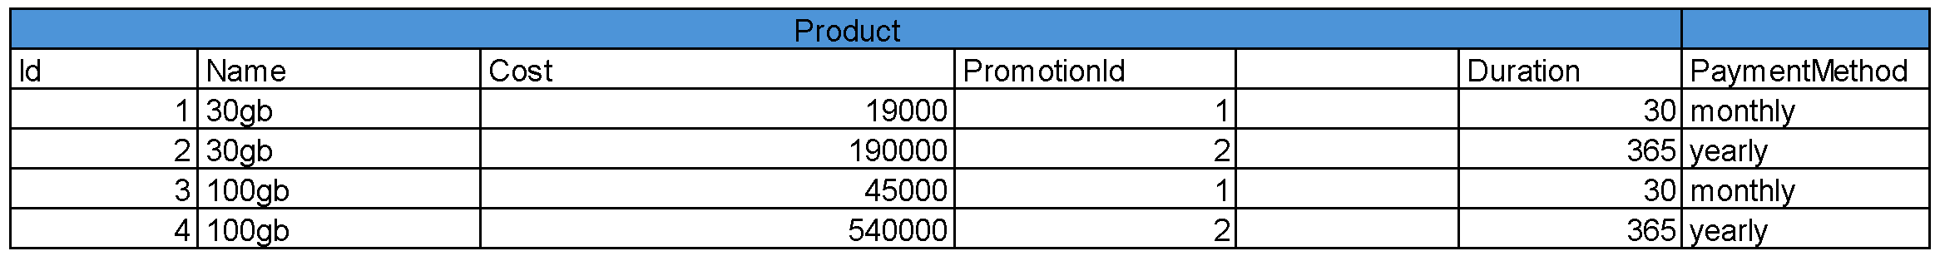
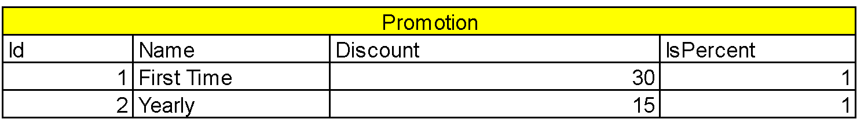
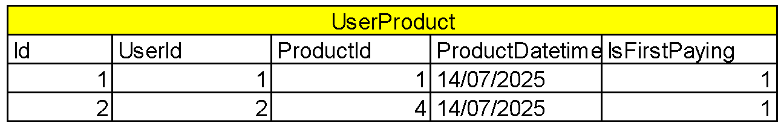

Slide 27
Get products can be bought by an user
select
p.Id,
p.Name as ProductName,
u.Name as UserName,
up.PayingDatetime,
up.EndDatetime,
pr.Name as PromotionName
from UserProduct up
join Products p on up.ProductId = p.Id
join Users u on up.UserId = u.Id
join Promotion pr on up.PromotionId = pr.Id
where u.Id = 199
Notes:
select
p.Id,
p.Name as ProductName,
u.Name as UserName,
up.PayingDatetime,
up.EndDatetime,
pr.Name as PromotionName
from UserProduct up
join Products p on up.ProductId = p.Id
join Users u on up.UserId = u.Id
join Promotion pr on up.PromotionId = pr.Id
where u.Id = 199

Slide 28
Resolve permission problem in Google Drive

Slide 29
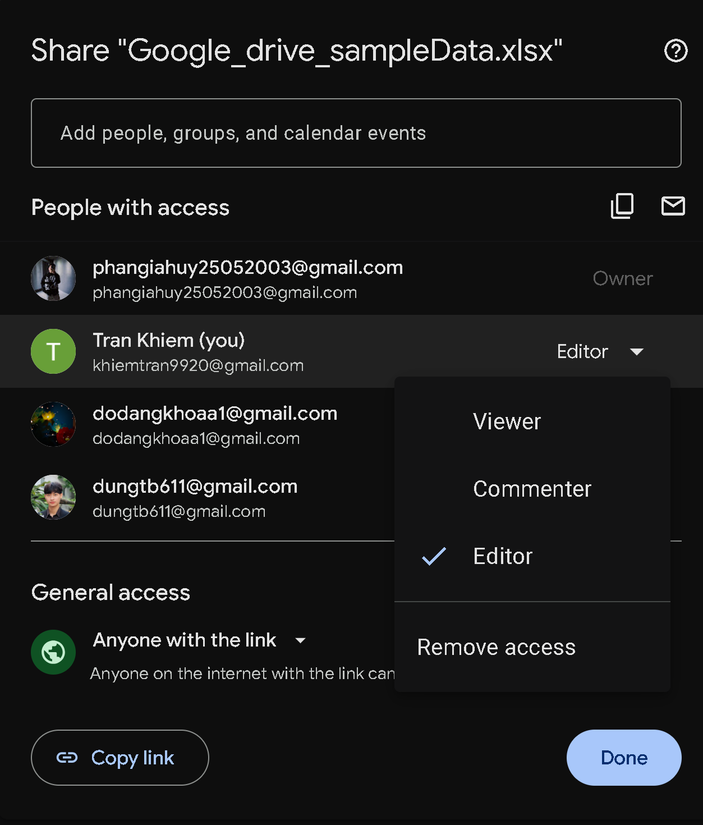
Share
Share
SharedUser
Permission

Slide 30
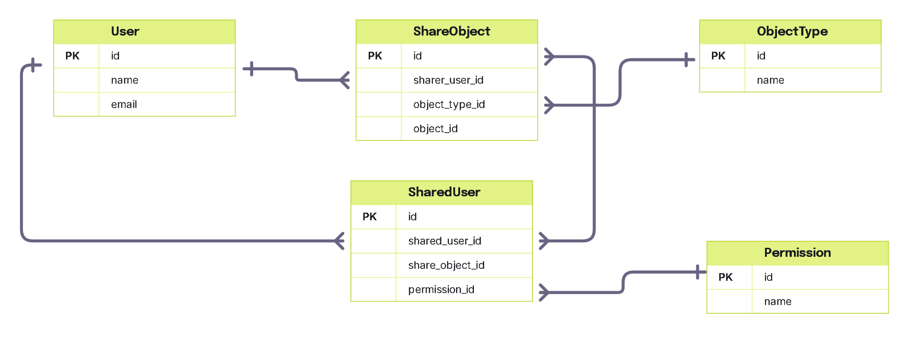
Table for Share feature

Slide 31
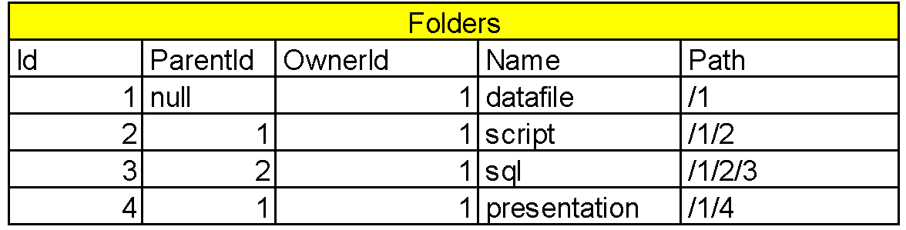
Add column “Path” to table folder
Track folder position in family tree

Slide 32
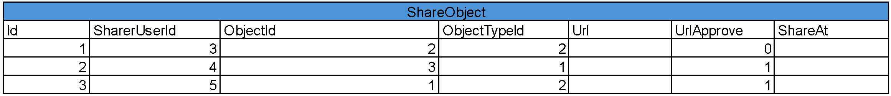
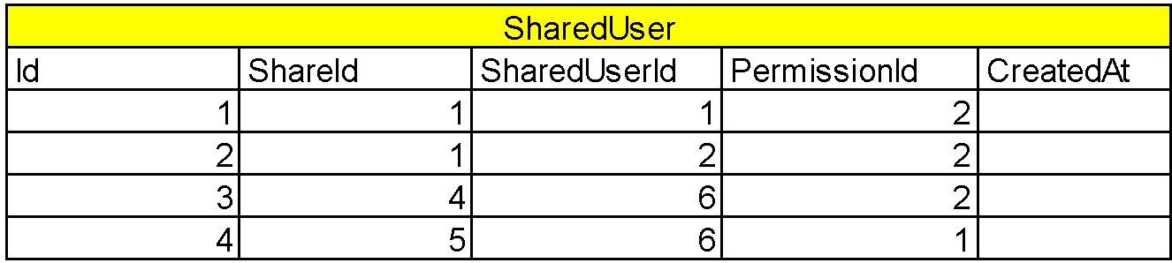
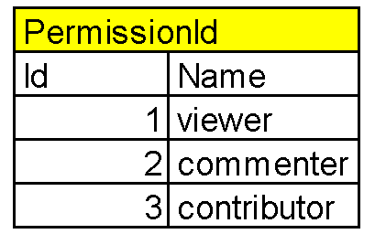
Sample data for share feature

Slide 33
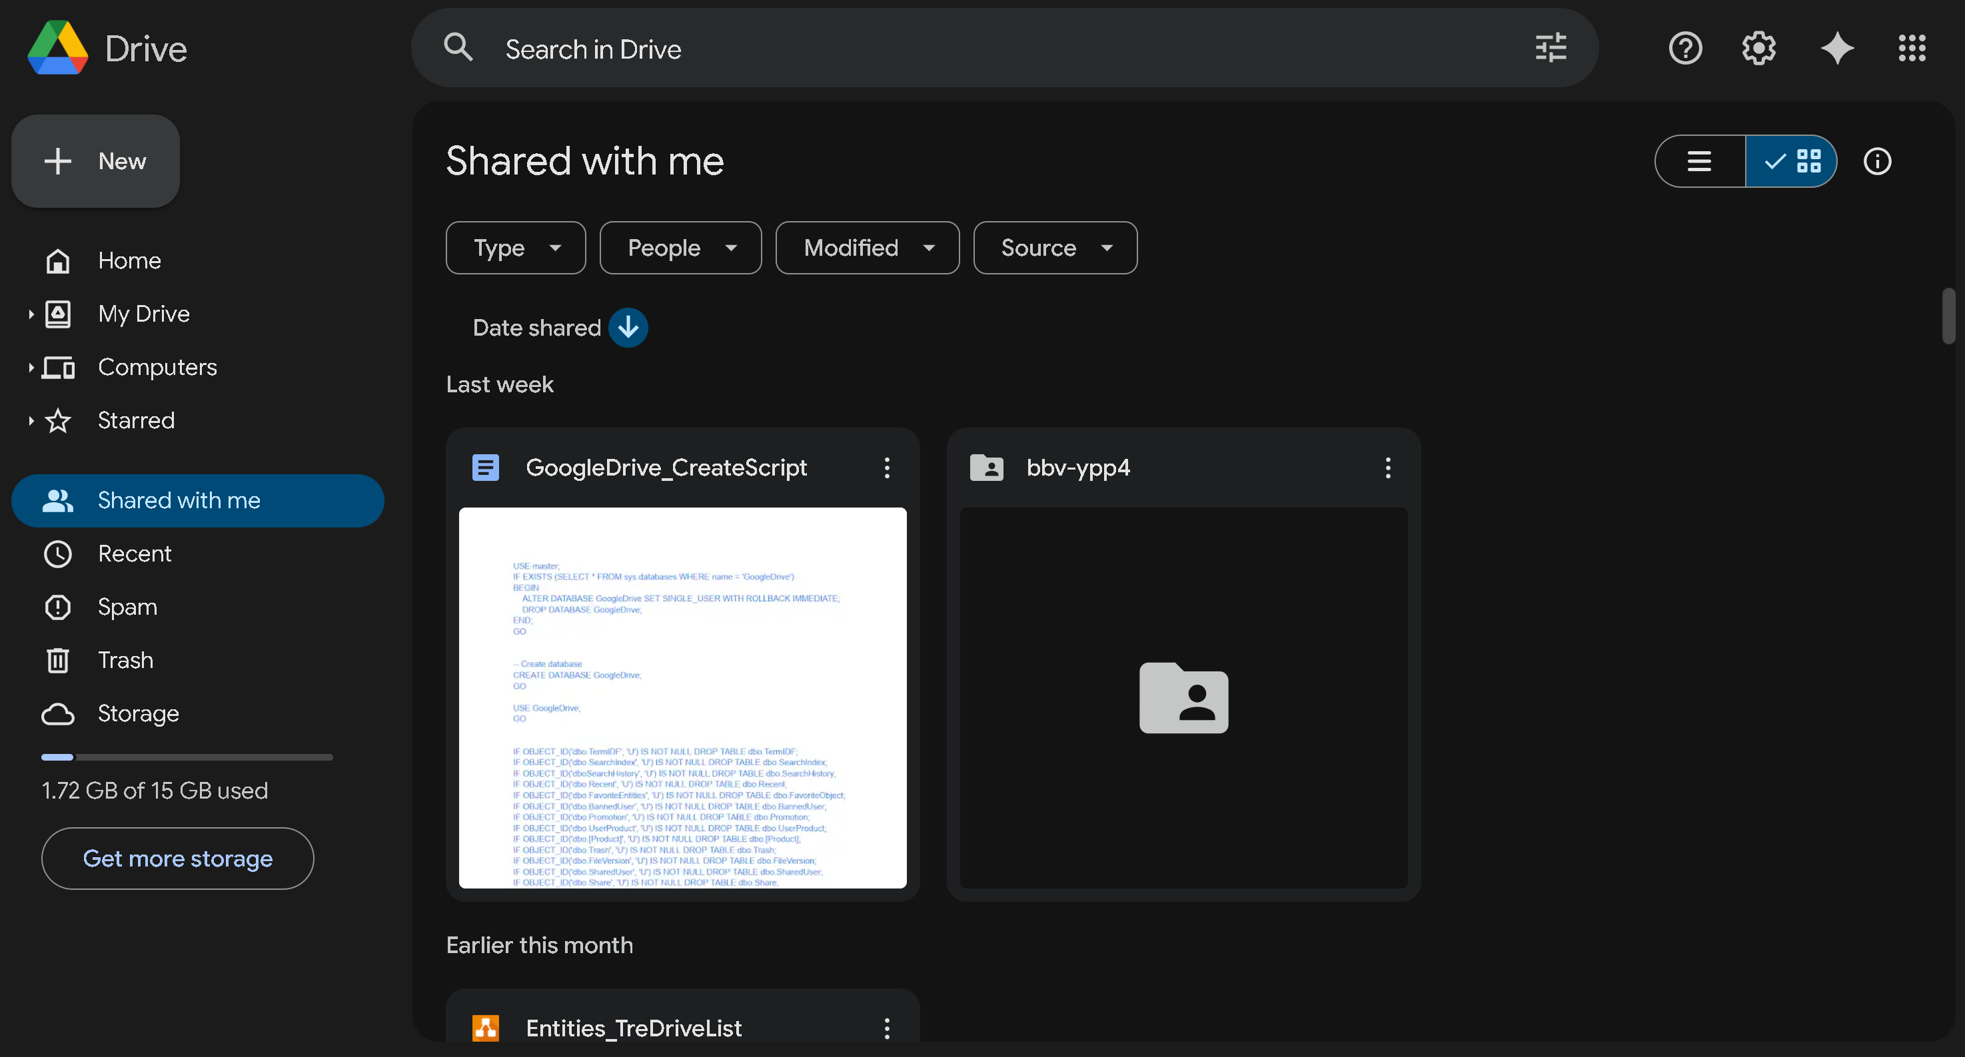
Get shared objects with an user
Notes:
--get shared objects with an user
select
s.ObjectId,
s.ObjectTypeId,
ot.Name as ObjectType,
case
when s.ObjectTypeId = 1 then f.Name
else fi.Name
end as [Name],
p.Name as Permission,
u2.Name as SharerName,
s.CreatedAt as ShareCreated,
s.ExpiresAt as ShareExpires
from SharedUser su
join Share s on su.ShareId = s.Id
join Users u on su.Id = u.Id
join Users u2 on s.Sharer = u2.Id
join ObjectType ot on s.ObjectTypeId = ot.Id
join Permission p on su.PermissionId = p.Id
left join Folder f on s.ObjectId = f.Id and s.ObjectTypeId = 1
left join Files fi on s.ObjectId = fi.Id and s.ObjectTypeId = 2
where su.UserId = 1
and s.ExpiresAt > GETDATE()
order by s.CreatedAt DESC;

Slide 34
select
s.ObjectId,
s.ObjectTypeId,
ot.Name as ObjectType,
case
when s.ObjectTypeId = 1 then f.Name
else fi.Name
end as [Name],
p.Name as Permission,
u2.Name as SharerName,
s.CreatedAt as ShareCreated,
s.ExpiresAt as ShareExpires
from SharedUser su
join Share s on su.ShareId = s.Id
join Users u on su.Id = u.Id
join Users u2 on s.Sharer = u2.Id
join ObjectType ot on s.ObjectTypeId = ot.Id
join Permission p on su.PermissionId = p.Id
left join Folder f on s.ObjectId = f.Id and s.ObjectTypeId = 1
left join Files fi on s.ObjectId = fi.Id and s.ObjectTypeId = 2
where su.UserId = 1
and s.ExpiresAt > GETDATE()
order by s.CreatedAt DESC;
Get shared objects with an user
Notes:
--get shared objects with an user
select
s.ObjectId,
s.ObjectTypeId,
ot.Name as ObjectType,
case
when s.ObjectTypeId = 1 then f.Name
else fi.Name
end as [Name],
p.Name as Permission,
u2.Name as SharerName,
s.CreatedAt as ShareCreated,
s.ExpiresAt as ShareExpires
from SharedUser su
join Share s on su.ShareId = s.Id
join Users u on su.Id = u.Id
join Users u2 on s.Sharer = u2.Id
join ObjectType ot on s.ObjectTypeId = ot.Id
join Permission p on su.PermissionId = p.Id
left join Folder f on s.ObjectId = f.Id and s.ObjectTypeId = 1
left join Files fi on s.ObjectId = fi.Id and s.ObjectTypeId = 2
where su.UserId = 1
and s.ExpiresAt > GETDATE()
order by s.CreatedAt DESC;

Slide 35
Full-text Search with BM25

Slide 36
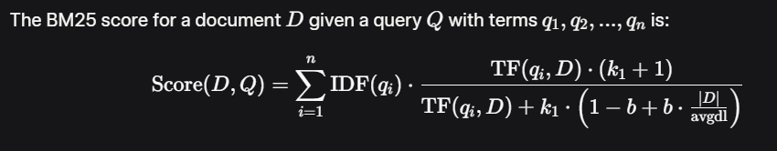
WHAT IS BM25 ?
How to score in BM25 ?

Slide 37
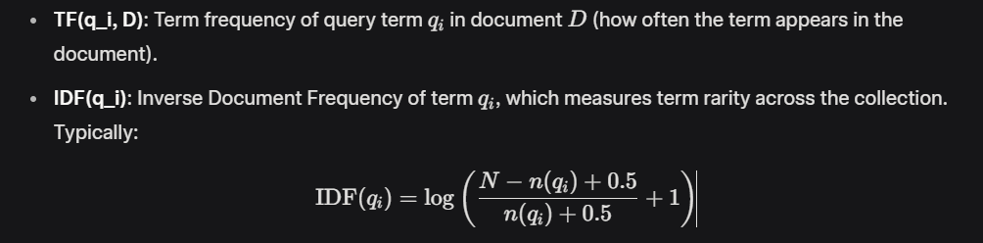
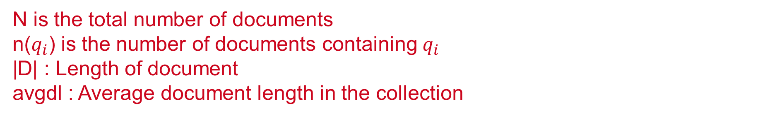
n(qi) is the number of documents containing qi a.k.a df
|D| : Length of document
avgdl : Average document length in the collection

Slide 38
k_1: A parameter (typically 1.2 to 2.0) controlling the impact of term frequency. Higher values allow more influence from frequent terms.
b: A parameter (typically 0.75) controlling the effect of document length normalization. b=0 disables length normalization, while fully normalizes by document length.

Slide 39
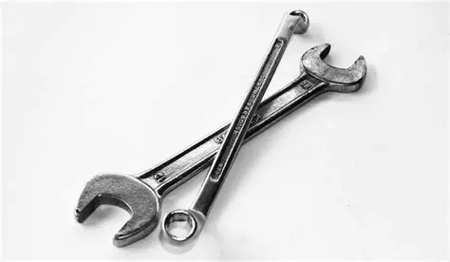
HOW DOES IT WORKS ?

Slide 40
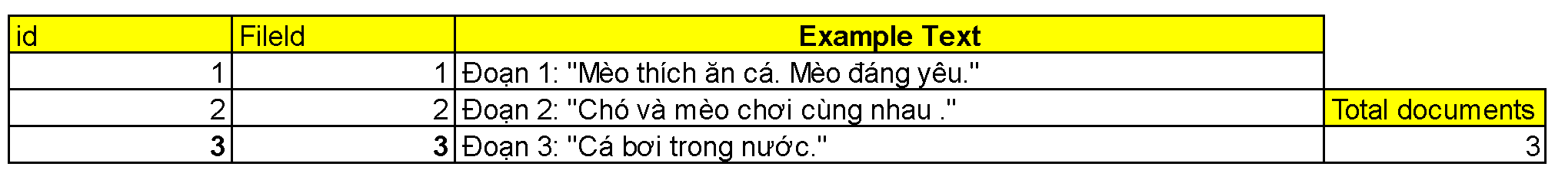
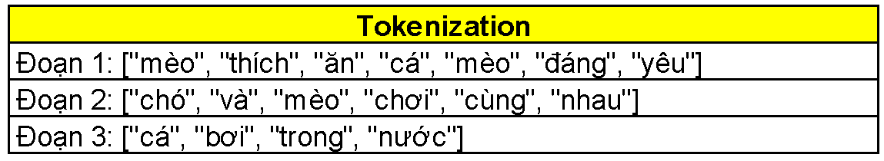
Tokenization

Slide 41
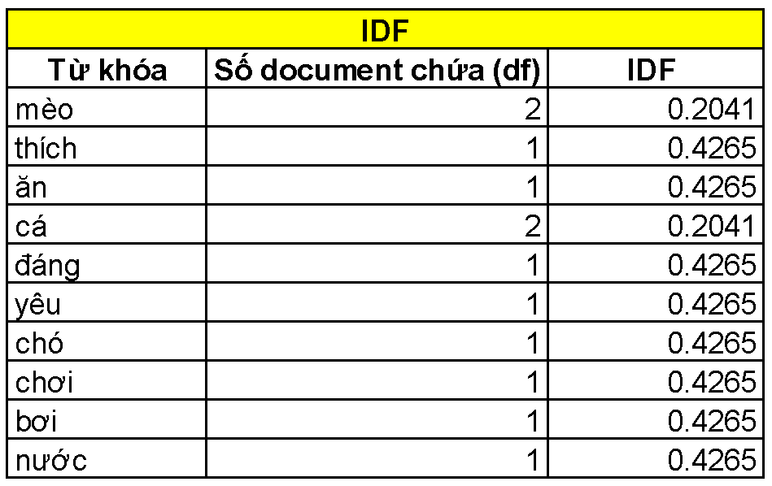
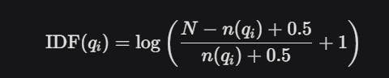
Caculate IDF ( InverseIndexFrequency)
N=3
n(qi)=df(documentfrequency)

Slide 42
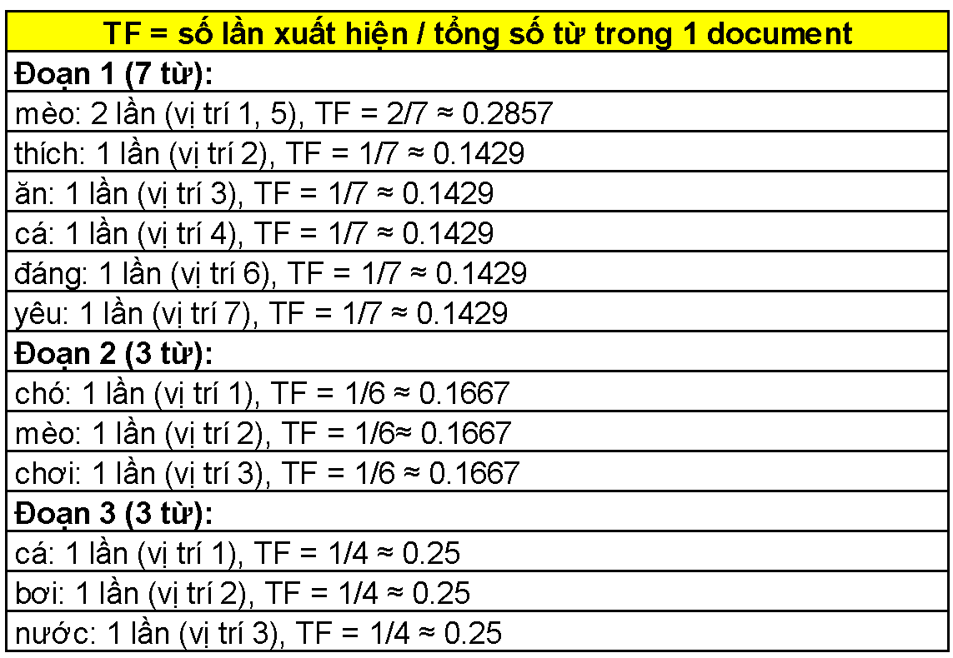
TF (TermFrequency)
Tf = ApperanceCount / |D|

Slide 43
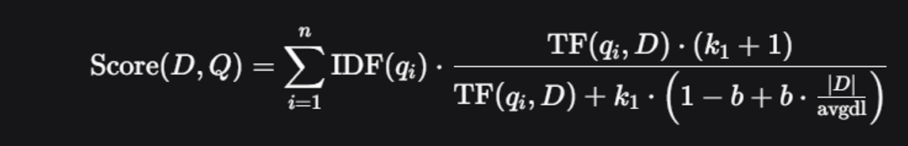
Total Score
k1=1.2
b=0.75
avgdl=5.67

Slide 44
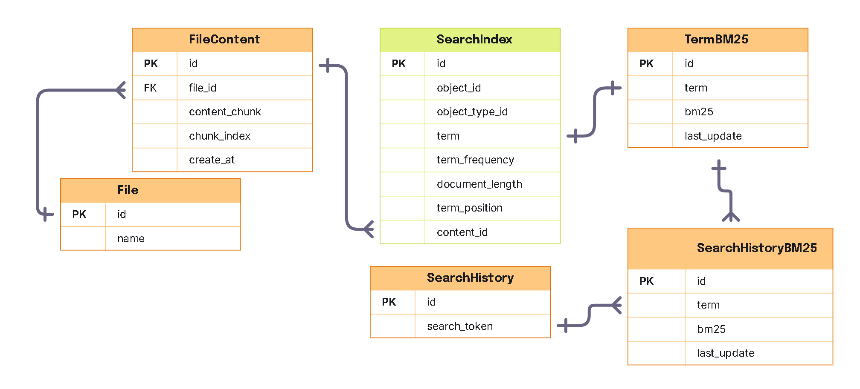
SQL Implement Full Text Search BM25

Slide 45
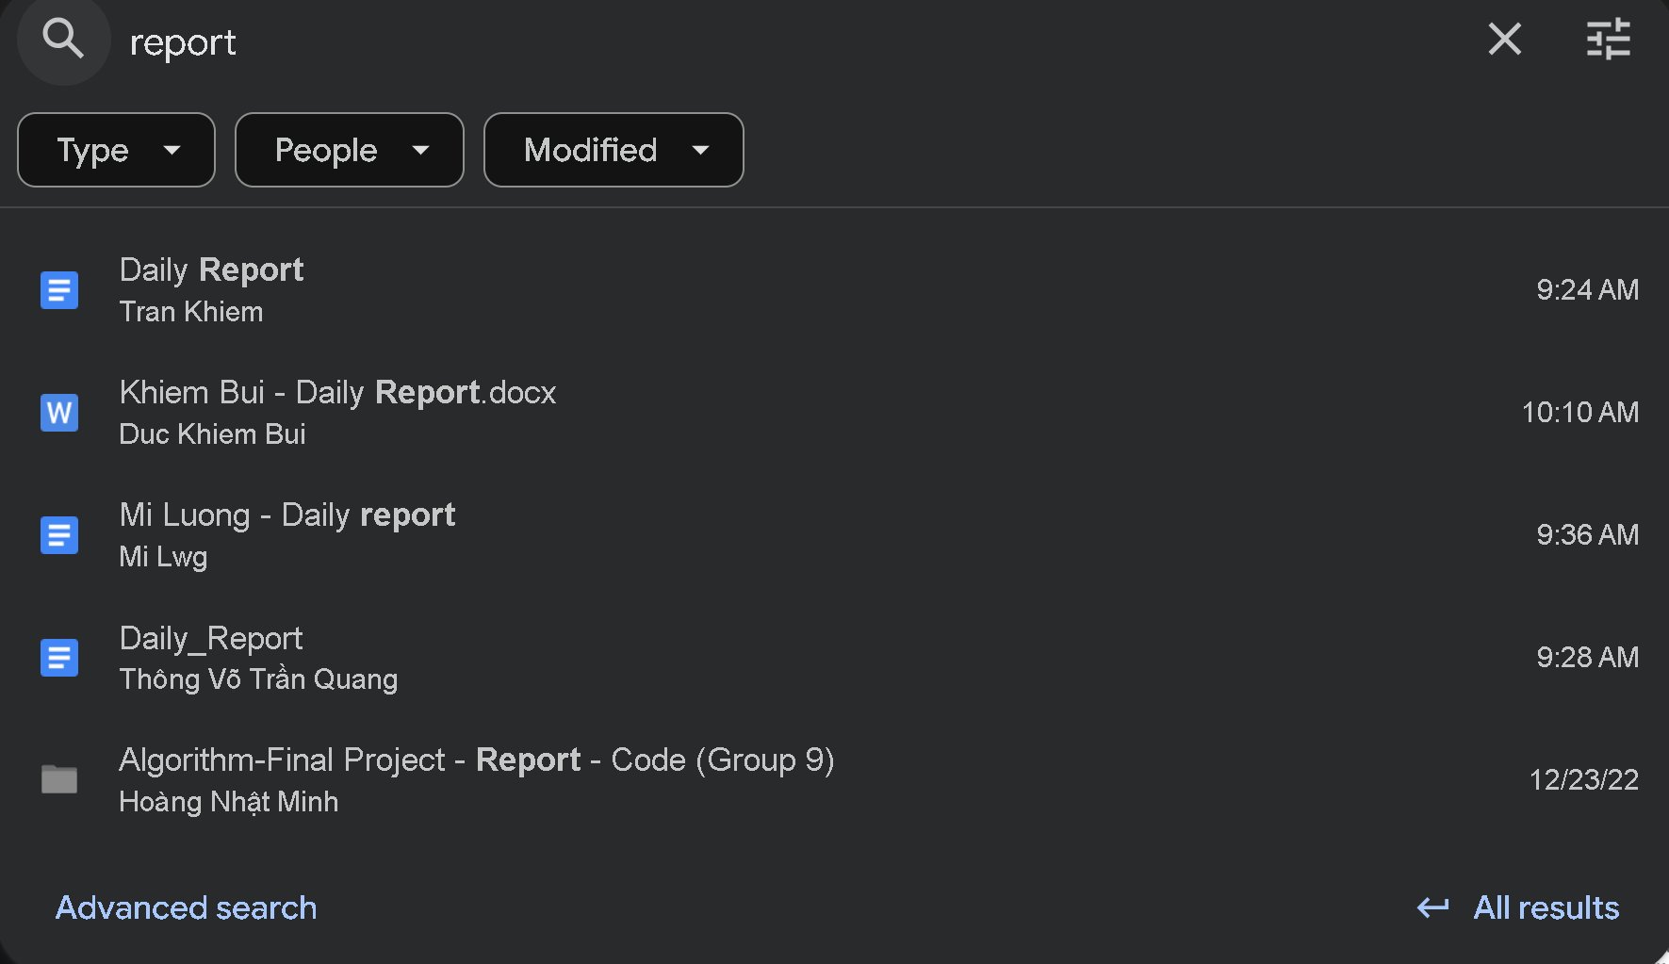
SQL Implement Full Text Search BM25
Get 5 most relevant files/folder related to keyword ‘report’

Slide 46
SQL Implement Full Text Search BM25
Get 5 most relevant files/folder related to keyword ‘report’
SELECT
s.ObjectTypeId,
s.ObjectId,
s.Term,
t.BM25
FROM SearchIndex s
join TermBM25 t on s.Term = t.Term
left join Folder f on f.Id = s.ObjectId and s.ObjectTypeId = 1
left join Files fi on fi.Id = s.ObjectId and s.ObjectTypeId = 2
WHERE t.Term IN ('report')
ORDER BY t.BM25 DESC;

Slide 47
Q&A

